Slide 1

6th Grade Accelerated Math
Unit 10, Lesson 6 Comparing Data Sets Volume 2, pg. 134

Slide 2


Benchmark
MA.7.DP.1.2
Given two numerical or graphical representations of data, use the measure(s) of center and measure(s) of variability to make comparisons, interpret results, and draw conclusions about the two populations.
volume 2, pg. 134

Slide 3
Integrated Mathematical Thinking and Reasoning Standards
MA.K12.MTR.1.1 Actively participate in effortful learning both individually and collectively.
MA.K12.MTR.2.1 Demonstrate understanding by representing problems in multiple ways.
MA.K12.MTR.4.1 Engage in discussions that reflect on the mathematical thinking of self and others.
volume 2, pg. 134

Slide 4

Learning Target
I can compare and interpret two numerical representations of data for two populations.
volume 2, pg. 134

Slide 5

Warm-Up
volume 2, pg. 134

Slide 6
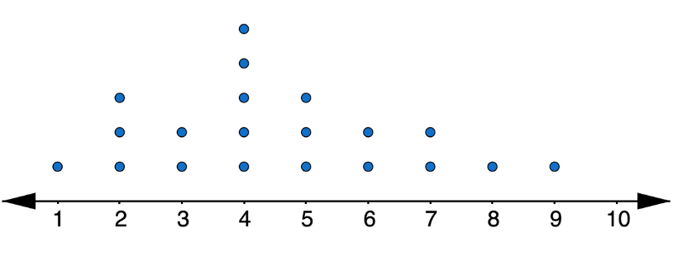
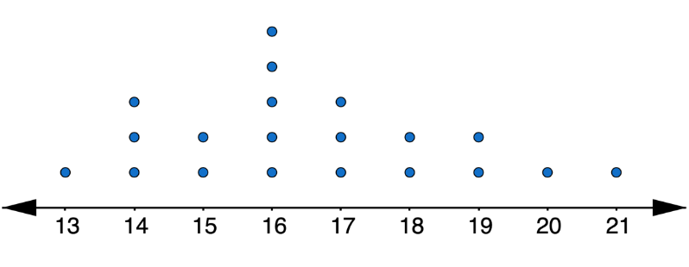
10.6.1 Warm-Up: Notice and Wonder
The line plots represent the distribution of the tip amounts, in dollars, left at two different restaurants on the same night.
Tip Amount (in dollars)
volume 2, pg. 134

Slide 7
Complete each statement.
When looking at the data displays, one thing I notice is …
b. One thing I wonder is …
volume 2, pg. 134

Slide 8

Exploration
volume 2, pg. 135

Slide 9

10.6.2 Exploration: Calculating Measures of Center and Variation
On a college entrance exam, the possible scores on the math section range from 200-800. Below are the scores for 20 randomly selected female high school seniors.
454 409 437 415 452 440 454 478 401 403 426 426 437 465 465 429 470 448 511 453
The scores for 20 randomly selected male high school seniors are shown below.
408 440 414 391 480 415 426 392 469 446 409 432 375 388 413 451 370 415 487 404
volume 2, pg. 135

Slide 10
Work with your partner to complete the table by calculating the measures of center and variability for each set of data.
Measure | Female Students | Male Students
Mean
Median
Range
IQR
Potential Outliers
volume 2, pg. 135

Slide 11
Complete the statements.
Female students tend to have scores
on the math section of the college entrance exam,
with a median of _______, than males, who have a
median of _______.
Scores for males tend to have variability,
with an IQR of _______, than scores for females,
with an IQR of _______.
lower
higher
less
more
volume 2, pg. 135

Slide 12
Explain why the measures median and IQR were chosen to describe the data sets above, instead of mean and range.
Check your work on Parts A-C with your partner and if necessary, resolve any differences.
volume 2, pg. 135

Slide 13

Try It
volume 2, pg. 136

Slide 14

10.6.3 Try It: Drawing Conclusions
Shawn wants to determine the best way to get to school. Over several weeks, he took turns riding in a car and riding his bicycle and recorded the time, in minutes.
Shawn calculated the measures of center and spread for each transportation method. They are shown in the table.
Car |  |  | Bicycle
19 | 17 |  | 24 | 25
15 | 18 |  | 27 | 26
12 | 22 |  | 21 | 28
29 | 14 |  | 32 | 23
 | Car | Bicycle
Mean | 18.25 | 25.75
Median | 17.5 | 25.5
Range | 17.0 | 11.0
IQR | 6.0 | 4.0
volume 2, pg. 136

Slide 15
 | Car | Bicycle
Mean | 18.25 | 25.75
Median | 17.5 | 25.5
Range | 17.0 | 11.0
IQR | 6.0 | 4.0
Car |  |  | Bicycle
19 | 17 |  | 24 | 25
15 | 18 |  | 27 | 26
12 | 22 |  | 21 | 28
29 | 14 |  | 32 | 23
Make an argument as to why Shawn should ride in a car to get to school.
Make an argument as to why Shawn should ride his bicycle to school.
volume 2, pg. 136

Slide 16

Activity
volume 2, pg. 136

Slide 17

10.6.4 Activity: Guess My Data Sets
Suppose an English teacher takes five random samples of students and records their most recent test scores.
Data Set A: {22, 0, 44, 40, 56, 32, 64, 44, 52, 60}
Data Set B: {60, 62, 62, 60, 64, 68, 64, 62, 68, 60}
Data Set C: {70, 82, 74, 76, 80, 72, 84, 70, 78, 82}
Data Set D: {72, 86, 100, 76, 92, 90, 100, 78, 98, 86}
Data Set E: {64, 36, 74, 82, 96, 80, 66, 78, 68, 0}
volume 2, pg. 136

Slide 18
Without telling your partner, choose two data sets from above.
Write a paragraph comparing the two data sets you have chosen using measures of center and variability. Make sure to refer to the data sets as “Data Set 1” and “Data Set 2” in the paragraph you write.
volume 2, pg. 136

Slide 19
Determine with your partner who is partner A and who is partner B. Write your names on the lines for each partner in the table.
Partner A should read their paragraph from Number 1 to partner B, and partner B will guess which two data sets were used. Then, partner B will explain their reasoning for their guess. Both partners will summarize the guess and reasoning in the first row of the table.
Then, switch roles so that partner B reads their paragraph while partner A makes a guess and explains their reasoning.
volume 2, pg. 137

Slide 20
Partner | Guess | Reasoning for Guess
Partner A: _________
Partner B: _________
Reveal to your partner which data sets were used and discuss any errors that may have led to incorrect conclusions.
volume 2, pg. 137

Slide 21

Your Turn
volume 2, pg. 137

Slide 22
10.6.5 Your Turn!
A company is trying to determine which method of communication is best to tell their employees important information. They send text messages to nine employees and emails to another nine employees. They record how many minutes it takes for the employees to reply.
Which measure of center best summarizes the data sets?
Text: Email:
Which measure of variability best summarizes the data sets?
Text: Email:
Text | 5 | 20 | 45 | 9 | 13 | 12 | 4 | 1 | 11
Email | 25 | 15 | 35 | 24 | 30 | 19 | 29 | 38 | 12
mean
median
mean
median
range
IQR
range
IQR
volume 2, pg. 137

Slide 23
Calculate the measures of center and variability.
Use the most appropriate measures of center and variability to compare the effectiveness of the two methods of communicating with employees.
Text | 5 | 20 | 45 | 9 | 13 | 12 | 4 | 1 | 11
Email | 25 | 15 | 35 | 24 | 30 | 19 | 29 | 38 | 12
 | Text | Email
Mean
Median
Range
IQR
volume 2, pg. 138

Slide 24

Wrap-Up
volume 2, pg. 138

Slide 25
10.6.6 Wrap-Up: Cool Down
Use the data from Your Turn to complete the prompt below.
Lucas recommends that the company emails its employees because of the smaller range in the data set. Explain why you agree or disagree with Lucas.
volume 2, pg. 138

